Slide 1
i3 Pitch Deck

Slide 2
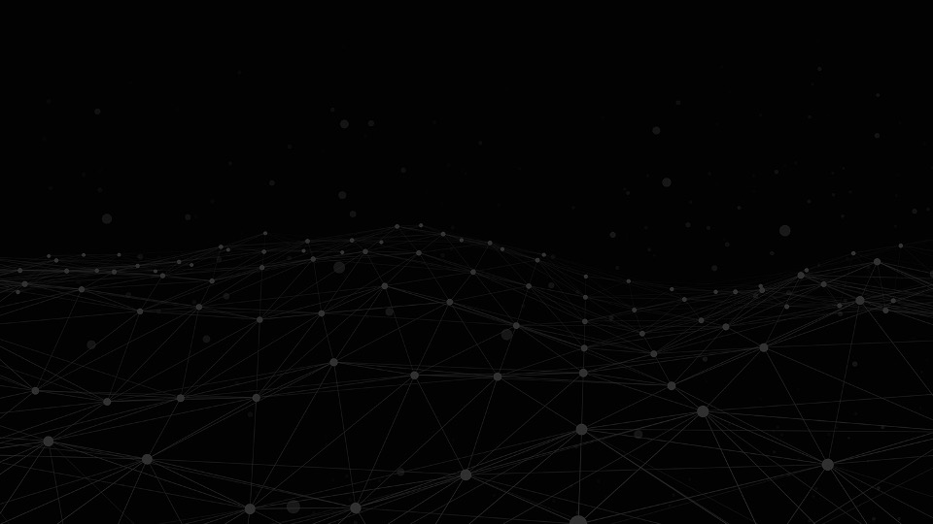

Velocity Vortex- Advanced Unified Reliability Operator/Server

Slide 3
Introduction
Team / Individual Name
Velocity Vortex- Add Blazing speed Reliability to any System With No Code
Name | Job Title | Email Address | Location
Kiran Sahoo | Sr Director, Distinguished Engineer | Kiran.sahoo2@spglobal.com | 55 Water Street, NY

Slide 4
Project Description
Executive Summary
Built from ground up in Rust/WASM , A blazing fast Reliability Proxy Server/Operator that protects system from Malicious queries/requests , provides Resiliency , Real time Monitoring ,Anomaly detection and Monetization Capabilities .
Threat Protection
Cost Analysis (GQL Queries)
Depth Limiting (GQL Queries)
Dynamic Rate Limiting (Per-User Basis)
Authentication/Authorization
Observability
UI that let’s the user track the performance of endpoints in real time and provide visualization of dependencies between various services
Anomaly Detection
Notification
Resiliency
Failover
Retry
Timeout
Chaos Engineering
Automates the testing of reliability of the system through observability and chaos engineering. Define user behavior in any language and swarm the system with millions of simultaneous requests. This reduces high severity incidents, downtime and ensure the deployments are successful and withstand any DDOS attack
Monetization
Build Monetization schemes to open up Revenue Streams
Velocity Vortex -an innovative solution that revolutionizes the management and protection of systems. With a focus on reliability, security, real-time monitoring , chaos engineering and performance, It addresses multiple critical aspects of system in a unified, seamless, no-code manner. The solution’s speed and efficiency, smaller memory/compute footprint and strong security has the potential to revolutionize cost saving strategies.
The solution offers comprehensive protection through cost analysis and depth analysis techniques ensuring that endpoints are shielded from unauthorized or malicious queries.
It incorporates failover mechanisms thereby providing a seamless user experience
Timeout and retry capabilities optimize performance by setting response time limits and automatically retrying failed or timed-out requests.
Cutting edge security built into it enables SSL termination functionality at the instance level there by enhancing application reliability
Advanced Observability let’s track the performance of endpoints in real time and provides visualization of dependencies between various services. This helps achieve actionable insights for proactive identification of bottlenecks, anomalies.
Dynamic Rate limiting functionality effectively controls and manages request processing, protecting against DoS attacks while ensuring fair resource allocation.
Chaos engineering built into it reduces high severity incidents, downtime and ensures the deployments are successful our executive summary must extract the main points of all sections.
The solution's no-code approach and its flexibility in offering multiple language bindings and deployment options empower architects, developers, and DevOps teams to efficiently handle various crucial aspects without the need for extensive coding knowledge, specialized development expertise, or reliance on multiple isolated tools. This enables them to ensure reliability, streamline operations, and effectively manage diverse requirements. It’s potential to replace disparate tools like Service Mesh, API Gateway, Nginx, and Monitoring tools, offers the opportunity to significantly reduce operational overhead and achieve significant cost savings.

Slide 5
Scope
Business Significance
Benefits & Strategic Fit
Threat Protection
Cost Analysis (GQL Queries)
Depth Limiting (GQL Queries)
Dynamic Rate Limiting (Per-User Basis)
Authentication/Authorization
Observability
UI that let’s the user track the performance of endpoints in real time
Anomaly Detection
Visualization of Dependencies between Services
Notification
Resiliency
Failover
Retry
Timeout
Chaos Engineering
Automates the testing of reliability of the system through observability and chaos engineering. Define user behavior in any language and swarm the system with millions of simultaneous requests. This reduces high severity incidents, downtime and ensure the deployments are successful and withstand any DDOS attack
Monetization
Build Monetization schemes to open up Revenue Streams
A unified solution that brings reliability and governance to any system in a no code manner and enables seamless user experience
Enhanced Resilience- Sits between the Clients and Backends Is designed to minimizes disruptions and downtime
Seamless User experience– Failover capabilities provides a seamless experience to the end users
Enhanced Security – Bolsters the overall posture of the system
Proactive Monitoring/Alerting – This leads to faster detection and resolution of issues
Cost Savings -The potential to revolutionize cost-saving strategies lies in the solution's ability to enhance speed and efficiency, reduce memory and compute requirements, ensure robust security, and replace disparate tools like APIGW, Proxy Server, Monitoring tools, and Service Mesh.
Governance :- A No code approach of bringing Reliability and better governance to the system
High Performant:-Built to be executed at near native speed with Zero Runtime Overhead
Scalability- High concurrency and Scalable Asynchronous Design
HTTP/1 , HTTP/2 and HTTP 3 support
Excellent Memory Efficient:- There is no garbage collection heap-allocation by default. System would know when the variable gets out of scope or its lifetime ends at compile time and thus insert the corresponding LLVM/assembly instructions to free the memory.
Safety :- Can be compiled to WASM. Each WASM module executes within a sandboxed environment separated from the Host Runtime , communicates to Host Via an API
Isolation:- Crashes in the module don’t impact other parts of the system
Portable and Interoperability- Wide Range of Language Bindings

Slide 6
Competitive Landscape
Likely Users
It’s competitive advantage lies in its ability to provide a no code approach of addressing multiple critical aspects of systems, ensuring reliability, security, failover, observability, anomaly detection and performance with a no-code approach..
With it’s potential to replace disparate tools like Service Mesh, API Gateway, Nginx, and Monitoring tools, this unified solution offers the opportunity to significantly reduce operational overhead and achieve significant cost savings.
Blazing fast, can process billions of messages in a day with bare minimum compute and memory
It’s groundbreaking capability to deliver comprehensive protection, as described below, sets it apart as the first of its kind. The solution incorporates
Failover mechanisms
Timeout/Retries
Dynamic Rate Limiting
Anomaly detection
Real time monitoring (UI)
Service Dependency Visualization
Chaos Engineering
Cost and Depth analysis techniques thereby protecting GraphQL Server from Malicious cyclical queries
Developers and Engineering Teams: This solution offers developers and engineering teams a comprehensive no-code approach for protecting, optimizing, and securing system. It simplifies the management of critical aspects such as cost analysis, depth analysis, failover, timeout, retries, SSL termination, real-time monitoring, rate limiting, and anomaly detection.
Security Professionals: This solution provides an advanced toolset to ensure the security and integrity of system
DevOps Teams: This solution capability to perform chaos engineering automates the process of adding reliability to the Pipeline
QA : This solution eases the process of testing the reliability of the system by letting the testers define user behavior in any language and swarm the system with millions of simultaneous requests
Architects:- Architects can leverage the solution’s no code approach of bringing reliability and streamlining operations thereby enabling them to effectively manage multiple critical aspects without requiring extensive coding or development expertise.

Slide 7
What Will It Take?
Resourcing
Time
Individual Contributor
Milestone 1 (1 month)
Threat Protection
Observability
UI for tracking service dependencies
Resiliency
Failover
Retry
Timeout
Chaos Engineering
Monetization
Milestone 2 (1 month)
Anomaly detection
Support for grpc
SSL termination
Risks
No Known Risks
Educated guess

Slide 8


